Slide 1

Over-Engineered and Under-Delivered Why Simplicity Wins in Data & AI

Slide 2
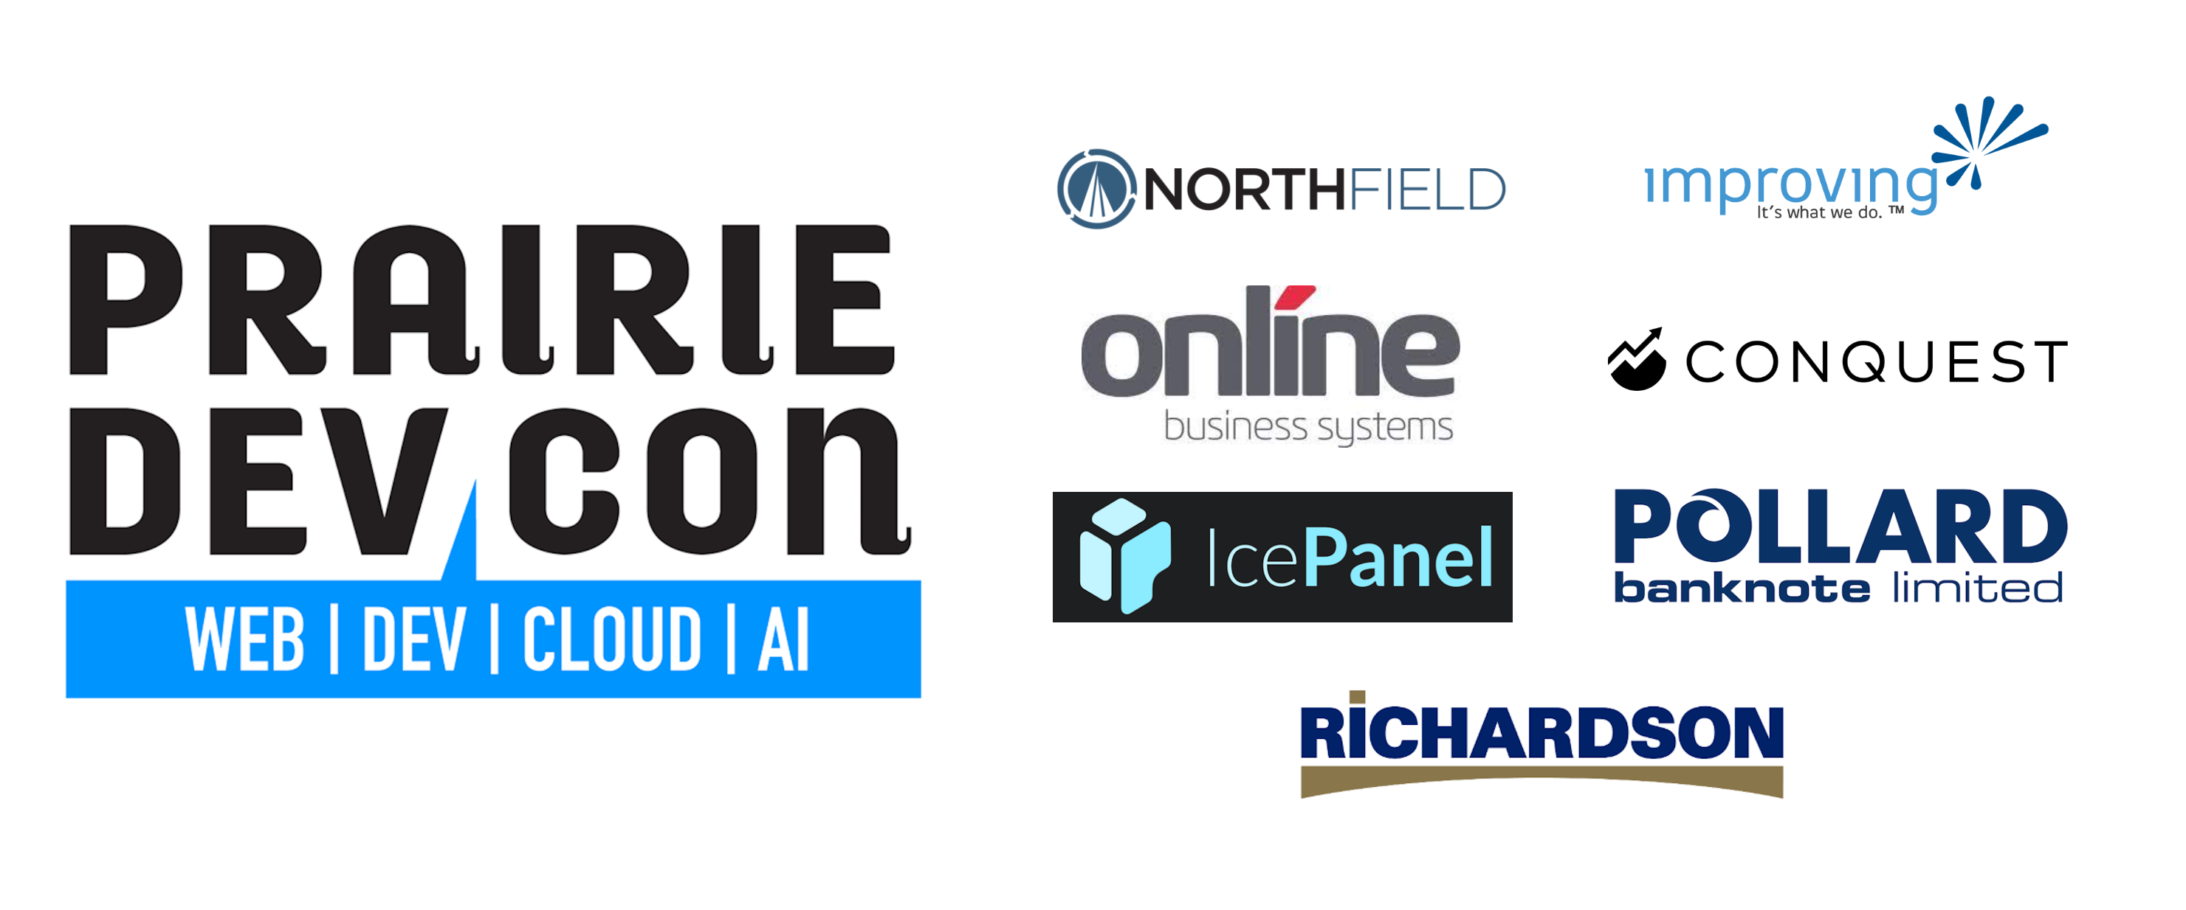

Slide 3

Agenda
The Complexity of a Data & AI Platform
The Principles Applied
Demo
Our Approach

Slide 4

About Me
Data Architect @ Plains Midstream Canada
Founding Engineer @ Code To Cloud
7+ years in various industries including energy, financial tech, and airlines holding various roles:
Cyber Security
DevOps Specialist
Software Developer
Data Engineer
Data Architect

Slide 5

Data & AI is Complicated! Why further complicate things with technology?

Slide 6
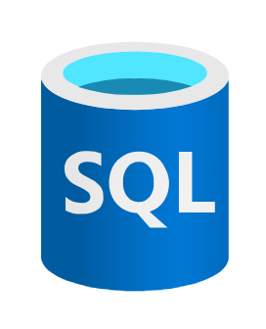
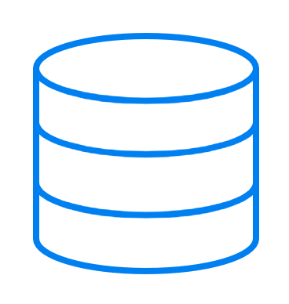

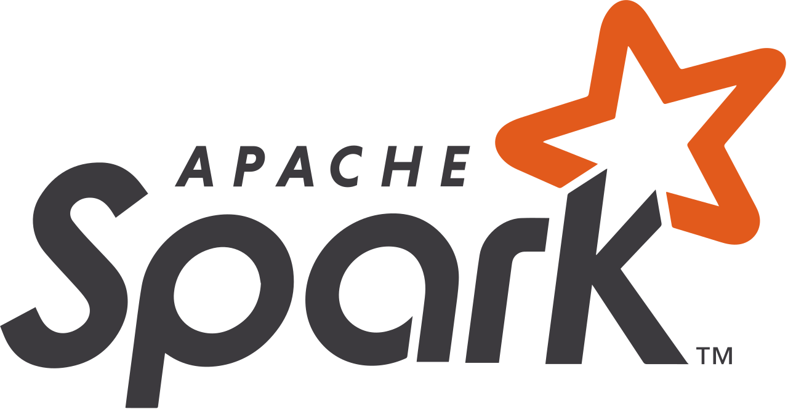



The Microsoft Reference Architecture Metadata Driven Pipelines in Azure Data Factory
‘Low code/no code’
Reduces ADF object duplication
ServerName | DatabaseName | TableName
Server1.database.window.net | db1 | Table1
Server2.database.window.net | db2 | Table2
Azure SQL
Source System(s)
Pipelines
Linked Services
ADLS Gen2
Azure Data Factory

Slide 7
The Alternative?
ServerName | DatabaseName | TableName
Server1.database.window.net | db1 | Table1
Server2.database.window.net | db2 | Table2
Source System(s)
Azure SQL
Pipeline for Table1
Linked Service for Server1
ADLS Gen2
Pipeline for Table2
Linked Service for Server2
Azure Data Factory

Slide 8
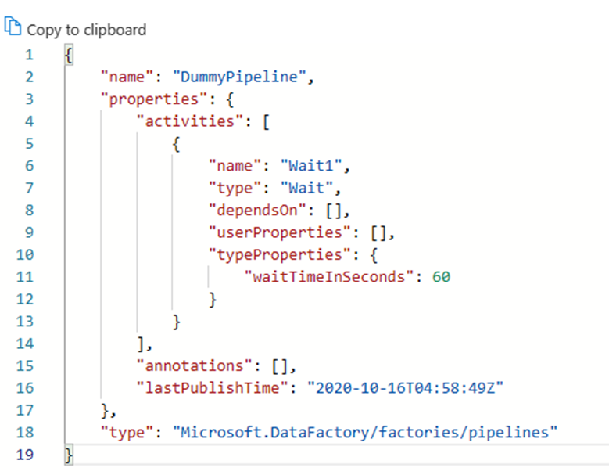
What's the problem metadata with driven pipelines in Azure Data Factory?
Testing is hard! No real unit tests.
ServerName | DatabaseName | TableName
Server1.database.window.net | db1 | Table1
Server2.database.window.net | db2 | Tabe2
Azure SQL
There is very likely lots of code here. Not as low code/no code as you think.
Source System
What happens when we need to handle source system nuances?
Pipelines
Linked Services
ADLS Gen2
Azure Data Factory

Slide 9



What's the problem with the metadata driven pipelines reference architecture in Azure Data Factory?
How do we unit test this?
x3 environments for dev, test, and prod?
Azure SQL
ADLS Gen2
Bronze
Silver
Gold
Source System
Azure Data Factory
Power BI
The ADF Integration with Databricks often does not support the latest features.
Azure Databricks
There is often lots of code in this layer!

Slide 10




The Life of a Data Engineer
‘I need to get this into production, how am I going to do that?’
The data looks wrong on the report!
I need to analyze work order trends
There goes my weekend…
‘I need to update the control table for my pipelines/triggers/linked services’
Step 3: Review the data in the silver layer to see if the problem is there. You will need to review the logs and scheduling.
Operations Team
Data Engineer
Step 2: Review the data in gold if the problem is there. You will need to review the logs and scheduling.
Azure SQL
ADLS Gen2
‘I need to create a new report’
wonum | description
1 | Pump-23 leaking suction
2 | Flat tire
‘I need to kick off the ingestion to bronze’
Bronze
Silver
Gold
Power BI
Azure Data Factory
‘I need to test the integration to the EAM’
‘I need to kick off the delta transformation to silver’
Step 1: Review your report to see if the data is refreshed.
EAM System
‘How will I incrementally load new work orders? I don’t want to do full loads’
Step 4: Review the data in the bronze layer to see if the problem is there. You will need to review the logs and scheduling.
‘I need to schedule/orchestrate all this’
Azure Databricks
‘I need to create write some code to handle a new transformation’

Slide 11
What business problem are we trying to solve?
Does the business care that we use Azure Data Factory to get the data into the bronze layer? Probably not.
Does the business care about the latency of the enterprise data? Most likely yes.
Does the business ever need to connect directly to the bronze data in the data lake? Maybe yes but rarely.
Does the business want consistent and timely access to accurate data? YES!
Stop debating technology and get to building and delivering value for your business!

Slide 12

The Complexity of Data & AI
Data comes in all shapes and sizes
The quality of the data is often not well understood
Data Governance is almost always lacking.

Slide 13
The Traditional Approach
What value does the additional orchestration layer provide?
“When we have a problem with the enterprise data (gold) how will I find the issue”?
“We aren’t a software development shop, low/no code tools are our only option”!
What about change data capture (CDC)?
Or this? What value does this add?
Azure SQL
Step 3: Review the data in the silver layer to see if the problem is there. You will need to review the logs and scheduling.
Step 2: Review the data in gold if the problem is there. You will need to review the logs and scheduling.
Besides the integration runtime, what value does this add?
Step 5: Review the source dataset.
ADLS Gen2
Step 1: Review your report to see if the data is refreshed.
Bronze
Silver
Gold
Not one of the supported CDC sources by ADF? No CDC for you!
Source System
Azure Data Factory
Power BI
Step 4: Review the data in the bronze layer to see if the problem is there. You will need to review the logs and scheduling.
There is often lots of code in this layer!
Azure Databricks

Slide 14

Does ADF Have a Time and Place?
Of course it does!
The integration runtime allows for easy access to on premise sources
Easy to get going with its low code interface
Lots of pre-built integrations

Slide 15
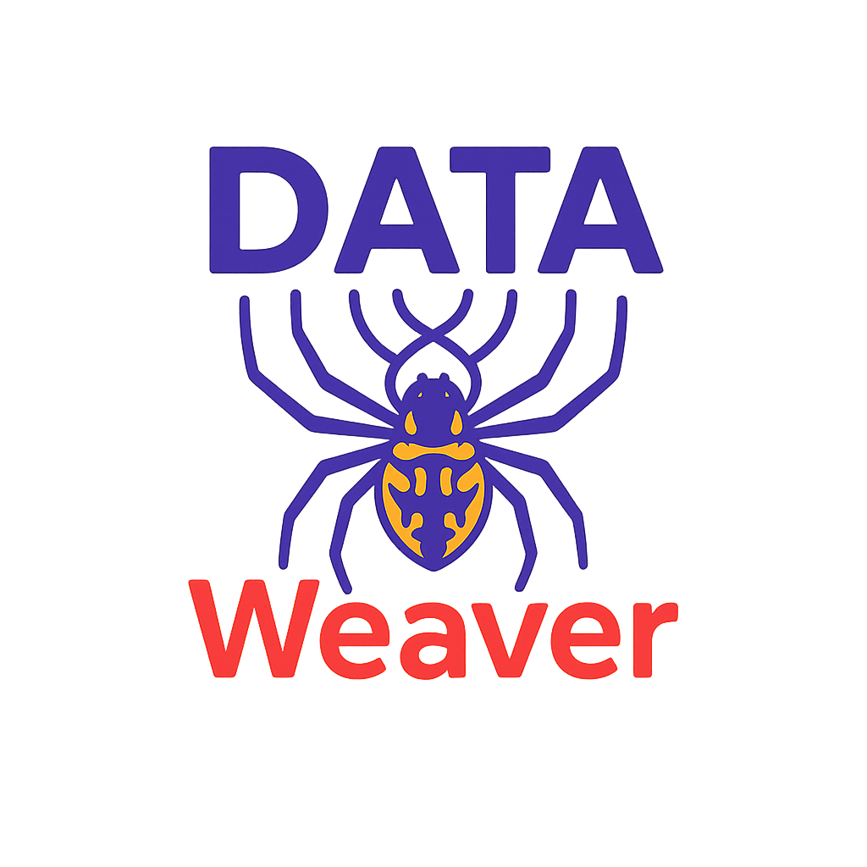
Our Approach
Databricks Workflows Performs Orchestration
“When we have a problem with the enterprise data (gold) how will I find the issue”?
🔮🪄 There is no magic here!
Just good software and platform engineering principals.
Python is a commodity skillset! Especially now with AI assistants.
x2 environments. Dev and Prod
One less layer/hop
ADLS Gen2
Silver
Gold
One tool/framework to operate
Power BI
One orchestration engine to run and schedule all your artifacts!
Source System
Azure Databricks

Slide 16

Am I Selling Databricks?
Databricks is just what we use at Plains.
There are lots of other great tools on the market that can do similar things!
What I want you to take away from this is the concepts.
Regardless of tool selection; I strongly believe these practices need to be in place regardless.

Slide 17

Applying Platform and Software Engineering Practices to Data & AI

Slide 18
Goals for the Platform
Meeting these goals equates to faster releases and generally faster time to value for our customers/business
Merge branches to trunk at least once a day
No code freezes
Average Code review time less than 30 mins

Slide 19

Software Engineering
Object-Oriented Programming (OOP)

Slide 20
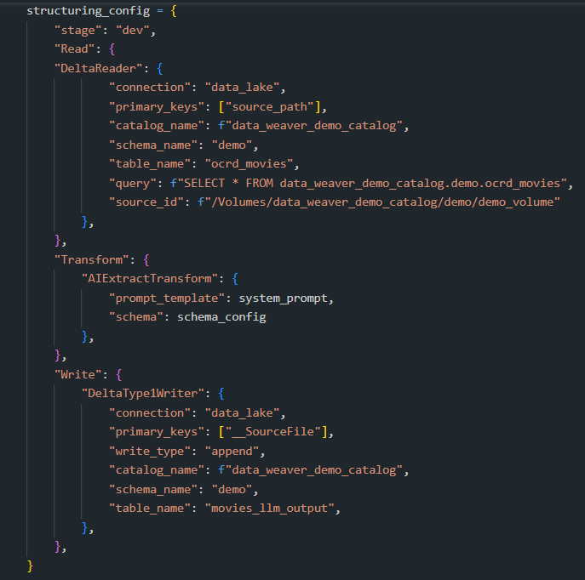
Class ETLJob()
Readers:
SQLServerReader()
FileShareReader()
etc.
Transforms:
TrimWhiteSpace()
AIExtractTransform()
etc.
Writers:
SCDType1Writer()
SCDType2Writer()

Slide 21
Platform Engineering
Improving the Developer Experience

Slide 22
Platform Engineering
Agreed upon infrastructure templates (ie: Terraform)
Continuous Integration/Continuous Deployment (CI/CD)
Templating code (ie: Accelerators)

Slide 23



CI/CD
CI Pipeline
PR Pipeline
CD Pipeline
Deploy to Databricks Dev
Run Tests
Deploy to Databricks Prod
Approval Gate
If Pass
Allow PR
If Fail
Deny PR
Developer
Pull Request
Master
Feature

Slide 24
Just a reminder… there is no magic here!
These processes need to be in place regardless of your architecture

Slide 25

Demo

Slide 26
So before adding yet another tool, ask yourself: Is this truly solving a business problem, or are we just making things harder for ourselves?

Slide 27


Pick a tool and stick with it…
Microsoft Fabric
Snowflake
Databricks

Slide 28






Connect With Me! Any Questions?
Code To Cloud
LinkedIn
Personal Blog

